Slide 1
Digital Forensics –
Machine & Network Reviews
Garry Singh
Garry.Singh@iirisconsulting.com
+91.9910036020
www.iirisconsulting.com
© 2016

Slide 2
Table of Contents
IIRIS – Overview
Digital Forensics
Rules
Process
Machines – computers, mobiles, servers
Network Forensics
In the court room
Case Study
“I keep six honest serving men (they taught me all I knew); Their names are What and Why and When and How and Where and Who.” - Rudyard Kipling

Slide 3
IIRIS Overview
INDUS INTELLIRISK & INTELLISENSE SERVICES PVT. LTD.

Slide 4
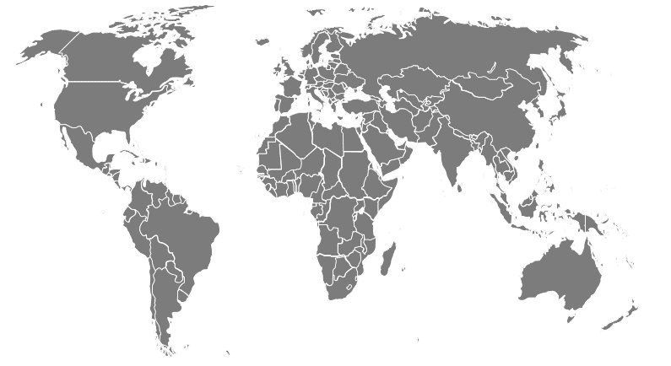
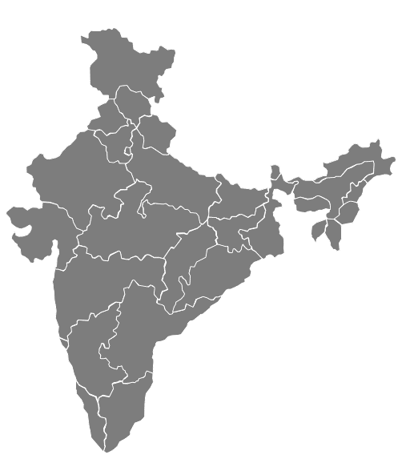
IIRIS Locations
SECURITY RISK
3RD PARTY RISK
AMERICAS
USA
Seattle
San Jose
North Carolina
EUROPE
England
ASIA
India
China
Sri Lanka
Bangladesh
Singapore
AUSTRALIA
Melbourne
MAJOR HUBS
Delhi – NCR
Mumbai
Bangalore
Kolkata
Hyderabad
INTERNAL RISK
IIRIS has capability to operate globally through vetted partners other than own offices

Slide 5
Digital Forensics
A computer lets you make more mistakes faster than any invention in human history-with the possible exceptions of handguns and tequila

Slide 6
Global Cyber Crime

Slide 7
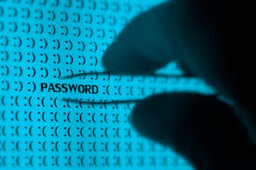
What is Digital Forensics?
Digital forensics is the practice of collecting, analysing and reporting on digital information in a way that is legally admissible. It can be used in the detection and prevention of crime and in any dispute where evidence is stored digitally.
DIGITAL FORENSICS = preservation, collection, validation, identification, analysis, interpretation, documentation and presentation of after-the-fact digital information derived from digital sources

Slide 8
Why Forensics Needed
Identify the perpetrator
Identify the method/vulnerability of the network that allowed the perpetrator to gain access into the system
Conduct a damage assessment of the victimized network
Preserve the Evidence for Judicial action
SECURITY RISK
3RD PARTY RISK
INTERNAL RISK
Treat is as a tool to investigate rather investigation itself

Slide 9
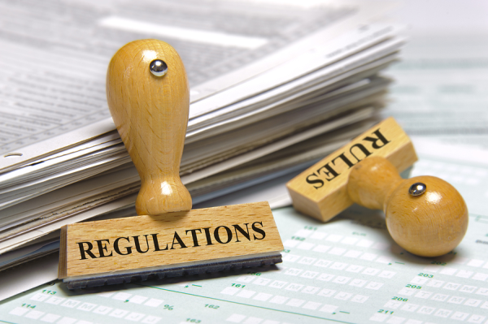
Rules
The basic rules for forensics are set-up through:
Laws
Indian Penal Code
Information Technology Act
Indian Evidence Act
Other Guidelines
International laws
Rules of software/tools
Company rules
SECURITY RISK
3RD PARTY RISK
INTERNAL RISK
“The first faults are theirs that commit them; The second faults are theirs that permit them.” - Thomas Fuller

Slide 10
Tools – Digital Forensics
Commercial
Encase
FTK
Open Source
SANS Investigative Forensics Toolkit
Volatility
Oxygen Forensic Suite
Helix
SECURITY RISK
3RD PARTY RISK
INTERNAL RISK

Slide 11
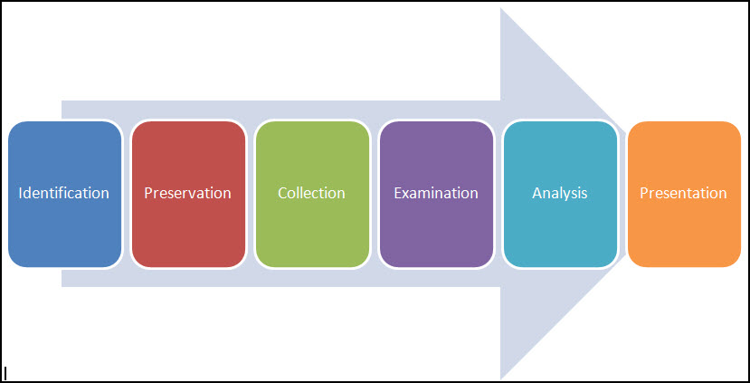
Process
SECURITY RISK
3RD PARTY RISK
INTERNAL RISK
“Life is the art of drawing sufficient conclusions from insufficient premises.” - Samuel

Slide 12
How forensics can help
Discussion – How Arushi murder case was solved?
SECURITY RISK
3RD PARTY RISK
INTERNAL RISK

Slide 13
How forensics can help contd..
Imagine if Arushi had a smart phone – possible to prevent
Imagine if digital alarms can be used – possible to respond
Examining devices of all involved – possible to have conclusive evidence based findings in much shorter time frame
SECURITY RISK
3RD PARTY RISK
INTERNAL RISK
Anyone else feel kinda weird when your computer asks you if you would like to continue unprotected?

Slide 14
Machines
COMPUTERS, SERVERS, PALMTOPS, PHONES
Human happiness and human satisfaction must ultimately come from within oneself. It is wrong to expect some final satisfaction to come from money or from a computer/phone.

Slide 15
Machines – What can be reviewed
All machines
Identification of device
Identification of user (user access can be broken)
Reference to connection
Time stamp of activity
Storage spaces and activities on that
Computers, servers, palm tops
Files including Office, pictures, videos, communication etc.
System files
Phones
Communications such as mails, messages
Call details
SECURITY RISK
3RD PARTY RISK
INTERNAL RISK

Slide 16
Top Locations for Evidence
There is no universal rule and evidence location will depend upon the case and objectives. Popular locations:
Chat apps
Internet History Files
Temporary Internet Files
Social networking
Contact lists
Mails and deleted mails
Settings, folder structure, file names
File Storage Dates
Software/Hardware added
File Sharing ability
SECURITY RISK
3RD PARTY RISK
INTERNAL RISK

Slide 17
Network Forensics
When internet is not working on computer I try to get it fixed as I still cant make out if computer can do other functions

Slide 18
Power of Internet
Populations
Germany – 82 million
France – 65 million
Europe – 743 million
Facebook active users – 1.6 billion
WhatsApp – 30 billion messages sent everyday that is 374,222 messages every second
Billions of dollars are lost through internet based frauds
SECURITY RISK
3RD PARTY RISK
INTERNAL RISK

Slide 19
Power of Internet contd..
SECURITY RISK
3RD PARTY RISK
INTERNAL RISK

Slide 20
What we can do on network
Location
Digitally
Investigation
IP Addresses
Identity
Communicate with fraudsters/victims
Recoveries
Data analysis – video, audio, files, chats etc.
SECURITY RISK
3RD PARTY RISK
INTERNAL RISK

Slide 21
Complexities of network forensics
Information sources
Corporate
Countries
International laws
Privacy norms
Fraud to reflect IP
Encryption
SECURITY RISK
3RD PARTY RISK
INTERNAL RISK

Slide 22
In the Courtroom
The penalty for laughing in a courtroom is six months in jail; if it were not for this penalty, the jury would never hear the evidence.

Slide 23
Most Critical - Procedure
Just for reference the guidelines laid down by the Association of Chief Police Offices (ACPO) of England, Wales and Northern Ireland:
Principle 1: The data held on an exhibit must not be changed.
Principle 2: Any person accessing the exhibit must be competent to do so and explain the relevance and the implications of their actions.
Principle 3: A record of all processes applied to an exhibit should be kept. This record must be repeatable to an independent third party.
Principle 4: The person in charge of the investigation has responsibility for ensuring that the law and these principles are adhered to.
SECURITY RISK
3RD PARTY RISK
INTERNAL RISK
Chain of Custody – as important as evidence

Slide 24
Tips for Presenting Evidence
Tip 1: Ensure that you have legal authorization to examine data on the device seized
Tip 2: Record the chain of custody for any device in your possession
Tip 3: Maintain data integrity
Tip 4: Validate your results
SECURITY RISK
3RD PARTY RISK
INTERNAL RISK

Slide 25
Tips for Presenting Evidence
Tip 5: Develop a thorough reporting format that emphasizes key findings
Tip 6: Be confident in the reliability of your evidence and your credibility as an examiner
Tip 7: Interpret data to tell a story
Tip 8: Use visuals whenever possible
Tip 9: Use expert witness
SECURITY RISK
3RD PARTY RISK
INTERNAL RISK

Slide 26
Case Study

Slide 27
Case Study
Information received about possible counterfeiting ring operating between Indo-Nepal border and working primarily on counterfeiting of cigarettes
Preliminary investigations provided substantial information about such a ring operating and doing large business
A raid was planned on a storage location
During the raid a computer and two phones were seized while only two labour level employees were arrested
SECURITY RISK
3RD PARTY RISK
INTERNAL RISK

Slide 28
Case Study contd..
Forensics were conducted on the seized computer and phones
There were certain words, information pieces, mention about large money transactions, names etc. not matching with counterfeiting of cigarettes
Further analysis indicated involvement of international intelligence agencies using the route to smuggle detonators and other bomb making material
Many top India based terrorist names were revealed
SECURITY RISK
3RD PARTY RISK
INTERNAL RISK

Slide 29
“Today's problems come from yesterday's solutions”
- Senge
www.iirisconsulting.com

